Slide 1
An Empirical Analysis of Contract Structures in IT Outsourcing
How contract structures and provisions are determined.
Michael Potts

Slide 2
Executive Summary
Chen, Y., Bhardwaj, A. (2009). An Empirical Analysis of Contract Structures in IT Outsourcing. Information Systems Research, 20(4), 484-506.
Prior research and contribution
Objectives + Structure of Study
Four contract structure dimensions and their provisions
Two pricing structures, fixed price (FP) and time-and-materials (TM)
Prevalence of dimensions/provisions in different pricing structures
Structural hypotheses based on factors
Results + Discussion
Limitations and further research
Information Technology Outsourcing = ITO

Slide 3
Prior research and academic contribution
Prior research (IT industry):
Inclination for firms to outsource (Ang & Straub, 1998, Aubert et al, 1996, Grover et al, 1996)
Types of outsourced functions (Lacity et al, 1996, Quinn & Hilmer, 1994)
Variables influencing ITO performance (Grover et al, 1996, Lacity & Willcocks, 1998, Lee et al, 2004)
Chen, Y., Bhardwaj, (2009)
What provisions are used.
The factors that affect contract structure.

Slide 4
Structure of study
To find out the dimensions or provisions typically found in ITO
To find out which provisions are found typically with two different pricing structures.
To find out how asset specificity, process interdependence and prior interaction influences the contract design choice and extensiveness.

Slide 5
Method:
112 ITO contracts from the USA
Clients were from nine different industries (food, finance + banking), printing, chemicals, industrial machinery + equipment, petroleum + coal, electronic equipment, computer, and instruments + related products.
Coding used to determine outcomes – accuracy is validated/found reliable by various statistical means (e.g. Cohen’s coefficient)

Slide 6
Four contract structure dimensions and their provisions
Monitoring:
Periodic review
Audit
Benchmark
Technology refresh
Transition
Staffing
Disaster Recovery
Property Rights Protection:
Right to use
Ownership of new development
Confidentiality
Contingency Planning:
Termination for convenience (Suang, Wenyu & Yuanye, 2009) – Project revenue (no), contract inequality (glue vendors to deal) etc.
Right to modify contract
Contingency for specific event
Dispute Resolution:
Escalated mechanism
Arbitration
Litigation
Dimensions/provisions list developed from previous theorist frameworks
(Whang, 1992, Ryall & Sampson, 2006, Anderson & Dekker, 2005)

Slide 7
Two pricing structures, fixed price (FP) and time-and-materials (TM)
Fixed price: the price of the product or service is fixed. A prior contract or precedential structure for this may already exist, so fewer provisions may be needed in the client-vendor contract. Risk is at the vendor side due to often pre-ordained contract.
Time-and-materials: The pricing is based on the amount of time and materials that needs to be used to deliver the product or service. This contract is more malleable and subject to change with time. – Not as easy to estimate time of product completion.

Slide 8
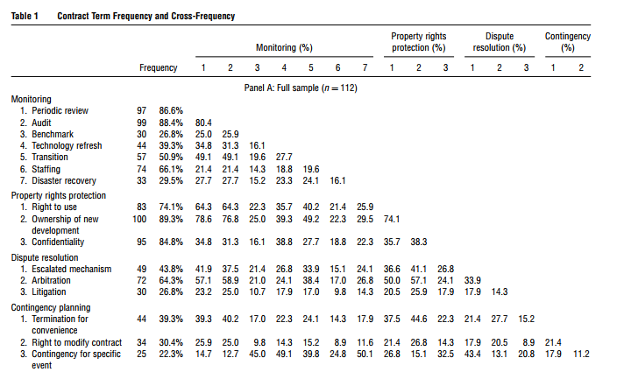
Prevalence of dimensions/provisions in different pricing structures

Slide 9
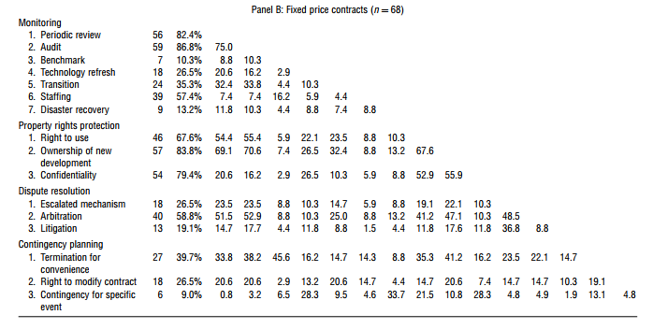
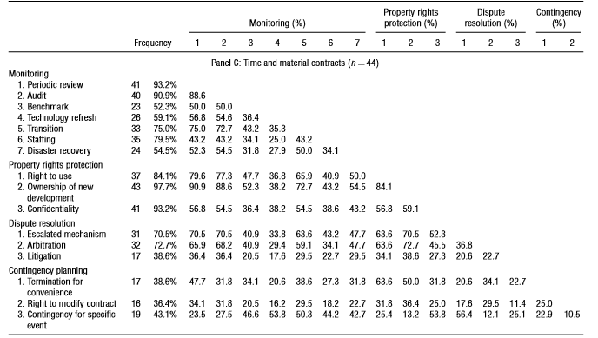
FP:
Monitoring: periodic review, audit
Property rights protection: Right to use, ownership, confidentiality.
“Risk of cost escalation is already mitigated by the pricing structure”
TM:
Monitoring: periodic review, audit, transition, staffing
Property rights protection: Right to use, ownership, confidentiality.
Dispute resolution: Escalated mechanism, arbitration

Slide 10
What are the determinants of the contract structure?

Slide 11
Asset Specificity
Where an asset is more valuable in a certain context
Exclusivity of the product
Consider this: You’re a software development company. A client approaches you and wants you to develop an app that specifically caters to their needs. Their needs are so specific that you are fairly certain you will never be able to use the code elsewhere to solve similar industry related problems. Basically, if the client pulls out of this deal, you will have wasted time and money with nothing to show for it.
Any other situations you have encountered?

Slide 12

Asset specificity hypotheses
Hypothesis 1(A)-(C)
(A)
(B)
(C)
Hypothesis 1(D)(i) or (ii)?
(i)
(ii)
Asset specificity = monitoring provisions
Asset specificity = property rights provisions
Asset specificity = dispute resolution provisions
Asset specificity = Contingency provisions
Asset specificity = Contingency provisions

Slide 13
Process interdependence
Where business processes need to be integrated
Systems from the vendor need integrating with the client
Consider this: You are the owner of a large hotel and you are outsourcing to a well established monitoring firm. You want an on-going monitoring system of people coming in and out of the hotel. Rather than simply having a separate program written for you entirely, it is easier for all the bottom-up systems to be integrated into your systems from the beginning.
Any other situations you have encountered?
Restaurants/Supermarket systems?

Slide 14
Process interdependence hypotheses
Hypothesis 2(A)-(D)
(A-D)
Hypothesis 2(E)
(E)
Process interdependence = monitoring, property rights, dispute resolution and contingency provisions.
Process interdependence = contract extensiveness

Slide 15
Prior Interactions
Any previous experience
It is speculated that previous interactions should result in a less extensive contract.
On the other hand, due to more codified processes between parties, better, more extensive contracts may result in prior interactions.

Slide 16
Prior interaction hypotheses
Hypothesis 3(A)-(C)
(A)
(B)
(C)
Hypothesis 3(D)(i) or (ii)?
(i)
(ii)
Prior interactions = monitoring provisions
Prior interactions = property rights provisions
Slightly +’ve for TM
Slightly –’ve for FP
Prior interactions = dispute resolution provisions
Prior interactions = Contingency provisions
Prior interactions= Contingency provisions

Slide 17
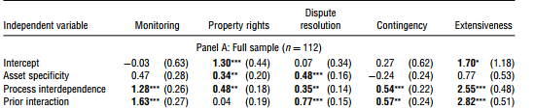


How the hypotheses faired in the empirical analysis
A B C D E
1(A)-(C)
1(D)(ii)
2(A)-(D)
2(E)
3(A),(C)
3(D)(i)
A B C D E
1(B)-(C)
2(A)-(D)
2(E)
3(A),(C)
3(D)(i)
A B C D E
1(A),(C)
2(A)-(D)
3(A)-(D)
3(D)(i)

Slide 18
Insights/Discussion
FP and TM
TM = greater risk as it is dependent on time input and materials input. Either of these could result in higher possibility of risk.
FP = lower risk because there may already be a large number of contractual provisions covered in the original pricing structure contract.
Monitoring pressures …

Slide 20
Insights/Discussion
FP and TM
TM = greater risk as it is dependent on time input and materials input. Either of these could result in higher possibility of risk.
FP = lower risk because there may already be a large number of contractual provisions covered in the original pricing structure contract.
Monitoring pressures
(auditing and periodic review) common for both to ensure quality control
TM require more processes due to more on-going time-component and higher risks
Contract extensiveness…

Slide 21
Contract Extensiveness

Slide 22
Insights/Discussion
FP and TM
TM = greater risk as it is dependent on time input and materials input. Either of these could result in higher possibility of risk.
FP = lower risk (client) because there may already be a large number of contractual provisions covered in the original pricing structure contract.
Monitoring pressures
(auditing and periodic review) common for both to ensure quality control
TM require more processes due to more on-going time-component and higher risks
Contract extensiveness
Prior experience = better understanding of mutual requirements and capabilities.
Therefore prior experience = more comprehensible contracts

Slide 23
Insights/Discussion cont…
Contingency planning not common
Hard to foresee contingency as a manager
N.B, of significance is the much higher ‘specific event’ contingency for TM contracts. Likely because on-going processes may increase risks of e.g. data loss.
Asset specificity can negatively affect contingency provisions because they cannot be used elsewhere, so more rigidity is needed.
Interdependence of process…

Slide 24
Process Interdependence

Slide 25
Insights/Discussion cont…
Contingency planning not common
Hard to foresee contingency as a manager
N.B, of significance is the much higher ‘specific event’ contingency for TM contracts. Likely because on-going processes may increase risks of e.g. data loss.
Asset specificity can negatively affect contingency provisions because they can potentially be used elsewhere.
Interdependence of processes
Across the board positive results
Full integration of systems needs extra contractual stipulations
As FP is also impacted by this, pricing terms alone do not remove all risks.

Slide 26
Limitations and future research
Limitations
Only 112 ITO contracts for 1993-2003. Ideally need a larger sample
Sample biased towards larger firms
Only comprising of U.S. companies
Secondary data sources used. Other variables like ‘level of trust’ to be considered
Binary code shows absence or presence of a provision (nothing in between)
Model doesn’t account for joint effects of some variables
Future Research
Richer coding mechanisms, differently weighted schemes, interaction terms for more nuanced results, performance implications based on choice of contract structure.

Slide 27
Further considerations
Chen, Y & Heng, C. S. (2012)
Higher client bargaining power = more control over contractual relationship (e.g. if the client has a bidding process prior to the contractual agreement, vendors will believe that they have competition.)
Current contracting process will likely influence future contracting processes. Prior interactions will result in an impetus for companies to create contracts that align with one another’s initiatives more.
The longer the contract, the greater chance of re-negotiation, shorter term contracts are recommended for the benefit of the client.

Slide 28
Conclusion
Payment structure affects provisions within an ITO contract
The nature of the transaction, such as asset specificity, process interdependence and prior interaction can affect monitoring, property rights, disputes resolution and contingency provisions.
Payment structure and nature of transaction effects contract extensiveness

Slide 29
Reference list
Chen, Y., & Bharadwaj, A. (2009). An empirical analysis of contract structures in IT outsourcing. Information Systems Research, 20(4), 484-506.
Chen, Y & Heng, C. S. (2012). Contract renegotiation and bargaining power: evidence from IT-related outsourcing agreements. In Proceedings of the 14th Annual International Conference on Electronic Commerce (pp. 229-236). ACM.
Heng, Du, and Feng. (2009). Investigating Vendors' Decision to Terminate IT Outsourcing Contracts. ICIS 2009 Proceedings, 32.

Slide 30
Questions?

